Slide 1

CS106A
Control Flow
Control Flow Revisited
Chris Piech
CS106A, Stanford University

Slide 2
Review

Slide 3

Java

Slide 4
Making a New Variable
type
name
int age = 29;
Initial value

Slide 5
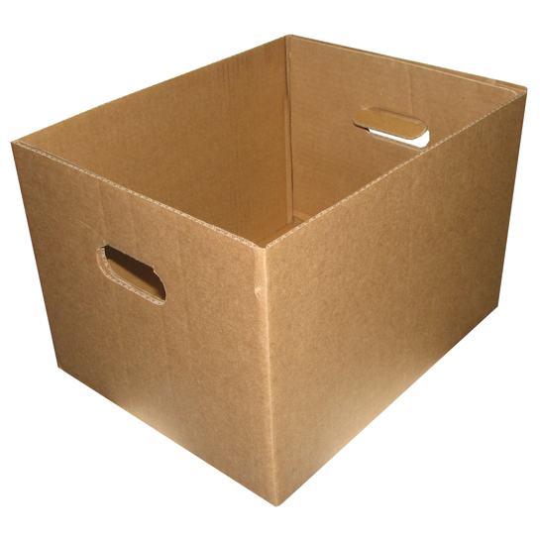
Teeny Tiny Boxes
My computer has space for about 2 billion boxes

Slide 6
Create, Modify, Use
// Create a variable, of type int
// called age with the value 30.
int age = 30;
// Modify age to be one greater.
age = age + 1;
// Use the value in age (output it)
println(“age is: ” + age);

Slide 7
Receipt Program Before
public class Receipt extends ConsoleProgram {
public void run() {
double subtotal = readDouble(”Meal cost? $”);
double tax = subtotal * 0.08;
double tip = subtotal * 0.20;
double total = subtotal + tax + tip;
println("Tax : $” + tax);
println("Tip: $” + tip);
println(”Total: $" + total);
}
}

Slide 8
Receipt Program After
public class Receipt extends ConsoleProgram {
private static final double TAX_RATE = 0.08;
private static final double TIP_RATE = 0.2;
public void run() {
double subtotal = readDouble(”Meal cost? $”);
double tax = subtotal * TAX_RATE;
double tip = subtotal * TIP_RATE;
double total = subtotal + tax + tip;
println("Tax : $” + tax);
println("Tip: $” + tip);
println(”Total: $" + total);
}
}
Notes:
Better because it’s easy to see what those numbers represent, and they are easy to change
Why do I need constants? – pi example

Slide 9
End Review

Slide 10
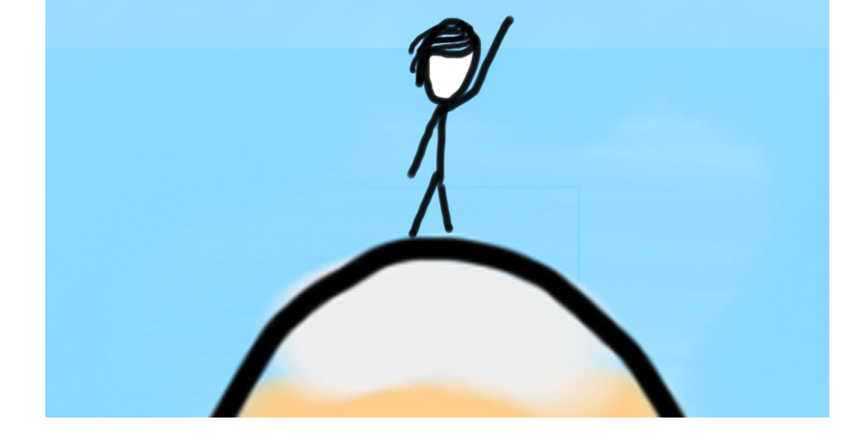

Today’s Goal
Be able to use For / While / If in Java

Slide 11



Today’s Route
You are here
Simple Java
For Loops
Scope
Conditions
Review
The River of Java

Slide 12
While Loop in Karel
while(frontIsClear()) {
body
}
if(beepersPresent()) {
body
}

Slide 13
While Loop Redux
while(condition) {
body
}
if(condition) {
body
}
The condition should be a “boolean” which is either true or false

Slide 14
Cool Example: Carbon Dating
C14 = 1.2 dpm
C14 = 13.6 dpm

Slide 15
Cool Example: Carbon Dating
// read the amount of C14 from the user
println("Carbon dating");
// read the amount of C14 from the user
double sampleC14 = readDouble("Amount of C14 in your sample: ");
// use the half life formula to calculate the age
double fractionLeft = sampleC14 / LIVING_C14;
double age = Math.log(fractionLeft) / Math.log(0.5) * HALF_LIFE;
println("Your sample is " + age + " years old.");
* It calculates the age of a C14 sample

Slide 16
Cool Example: Carbon Dating
Before repeating the body, check if this statement evaluates to true
while(true) {
// read the amount of C14 from the user
println("Carbon dating");
// read the amount of C14 from the user
double sampleC14 = readDouble("Amount of C14 in your sample: ");
// use the half life formula to calculate the age
double fractionLeft = sampleC14 / LIVING_C14;
double age = Math.log(fractionLeft) / Math.log(0.5) * HALF_LIFE;
println("Your sample is " + age + " years old.");
}
* It calculates the age of a C14 sample

Slide 17
Booleans
1 < 2

Slide 18
Booleans
1 < 2
true

Slide 19
Comparison Operators
Operator | Meaning | Example | Value
== | equals | 1 + 1 == 2 | true
!= | does not equal | 3.2 != 2.5 | true
< | less than | 10 < 5 | false
> | greater than | 10 > 5 | true
<= | less than or equal to | 126 <= 100 | false
>= | greater than or equal to | 5.0 >= 5.0 | true
* All have equal precedence

Slide 20
Comparison Operators
Operator | Meaning | Example | Value
== | equals | 1 + 1 == 2 | true
!= | does not equal | 3.2 != 2.5 | true
< | less than | 10 < 5 | false
> | greater than | 10 > 5 | true
<= | less than or equal to | 126 <= 100 | false
>= | greater than or equal to | 5.0 >= 5.0 | true
* All have equal precedence
Notes:
Equals is weird because single equals is assignment!

Slide 21
Comparison Operators
if (1 < 2) {
println("1 is less than 2");
}
int num = readInt("Enter a number: ");
if (num == 0) { println("That number is 0");
} else {
println("That number is not 0.");
}

Slide 22
If Else Revisited
int num = readInt("Enter a number: ");
if (num == 0) {
println("Your number is 0 ");
} else {
if (num > 0) {
println("Your number is positive");
} else {
println("Your number is negative");
}
}
Notes:
No redundant conditions

Slide 23
Else If
int num = readInt("Enter a number: ");
if (num == 0) {
println("Your number is 0 ");
} else if (num > 0) {
println("Your number is positive");
} else {
println("Your number is negative");
}
Notes:
No redundant conditions

Slide 24
Else If
int num = readInt("Enter a number: ");
if (num == 0) {
println("Your number is 0 ");
} else if (num > 0) {
println("Your number is positive");
} else {
println("Your number is negative");
}
Notes:
No redundant conditions

Slide 25
Else If
5
int num = readInt("Enter a number: ");
if (num == 0) {
println("Your number is 0 ");
} else if (num > 0) {
println("Your number is positive");
} else {
println("Your number is negative");
}
Enter a number:
5
Notes:
No redundant conditions

Slide 26
Else If
5
int num = readInt("Enter a number: ");
if (num == 0) {
println("Your number is 0 ");
} else if (num > 0) {
println("Your number is positive");
} else {
println("Your number is negative");
}
5
Enter a number:
5
num
Notes:
No redundant conditions

Slide 27
Else If
int num = readInt("Enter a number: ");
if (num == 0) {
println("Your number is 0 ");
} else if (num > 0) {
println("Your number is positive");
} else {
println("Your number is negative");
}
5
Enter a number:
5
num
Notes:
No redundant conditions

Slide 28
Else If
int num = readInt("Enter a number: ");
if (num == 0) {
println("Your number is 0 ");
} else if (num > 0) {
println("Your number is positive");
} else {
println("Your number is negative");
}
5
Enter a number:
5
num
Notes:
No redundant conditions

Slide 29
Else If
int num = readInt("Enter a number: ");
if (num == 0) {
println("Your number is 0 ");
} else if (num > 0) {
println("Your number is positive");
} else {
println("Your number is negative");
}
5
Enter a number:
5
Your number is positive
num
Notes:
No redundant conditions

Slide 30
Else If
int num = readInt("Enter a number: ");
if (num == 0) {
println("Your number is 0 ");
} else if (num > 0) {
println("Your number is positive");
} else {
println("Your number is negative");
}
5
Enter a number:
5
Your number is positive
num
Notes:
No redundant conditions

Slide 31

Conditions in Java
Use while and if statements in Java.
They are the same as in Karel, except that the test can be any expression that evaluates to true or false

Slide 32
Amazing

Slide 33
Secret

Slide 34

By Chris

Slide 35
Once upon a time…

Slide 36

X was looking for love!
int x = 5;
if(lookingForLove()) {
int y = 5;
}
println(x + y);
5
x

Slide 37
X was looking for love!
int x = 5;
if(lookingForLove()) {
int y = 5;
}
println(x + y);
5
x

Slide 38
X was looking for love!
x was definitely
looking for love
int x = 5;
if(lookingForLove()) {
int y = 5;
}
println(x + y);
5
x

Slide 39
And met y
int x = 5;
if(lookingForLove()) {
int y = 5;
}
println(x + y);
5
5
x
y

Slide 40
And met y
int x = 5;
if(lookingForLove()) {
int y = 5;
}
println(x + y);
5
5
Hi, I’m y
x
y

Slide 41
“Wow!”

Slide 42
And met y
int x = 5;
if(lookingForLove()) {
int y = 5;
}
println(x + y);
Wow
5
5
x
y

Slide 43
And met y
int x = 5;
if(lookingForLove()) {
int y = 5;
}
println(x + y);
5
5
We have so much in common
x
y

Slide 44
And met y
int x = 5;
if(lookingForLove()) {
int y = 5;
}
println(x + y);
5
5
We both have value 5!
x
y

Slide 45
And met y
int x = 5;
if(lookingForLove()) {
int y = 5;
}
println(x + y);
5
5
Maybe one day we can…
x
y

Slide 46
And met y
int x = 5;
if(lookingForLove()) {
int y = 5;
}
println(x + y);
5
5
println together?
x
y

Slide 47
They got along
int x = 5;
if(lookingForLove()) {
int y = 5;
}
println(x + y);
5
5
x
y

Slide 48
It was a beautiful match…

Slide 49
But then tragedy struck.

Slide 50
Tragedy Struck
int x = 5;
if(lookingForLove()) {
int y = 5;
}
println(x + y);
5
5
x
y

Slide 51
Tragedy Struck
int x = 5;
if(lookingForLove()) {
int y = 5;
}
println(x + y);
5
5
x
y

Slide 52
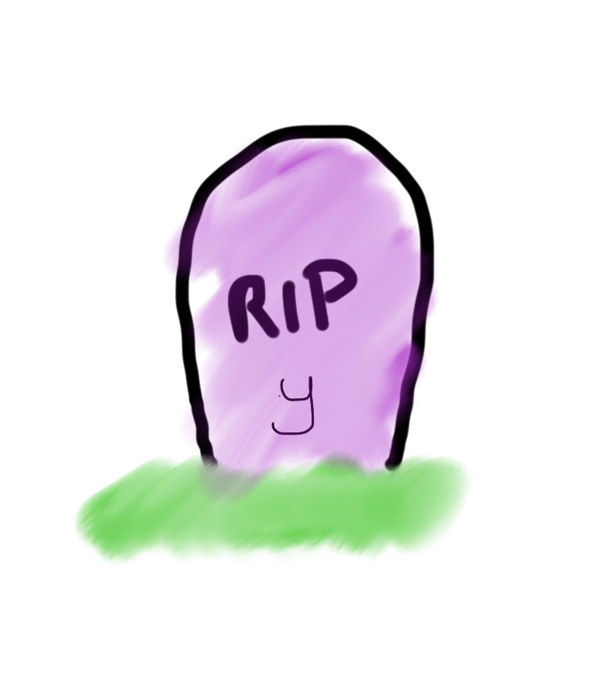
Tragedy Struck
int x = 5;
if(lookingForLove()) {
int y = 5;
}
println(x + y);
5
x

Slide 53
Noooooooooooooooo!

Slide 54
You see…

Slide 55
When a program exits a code block…
int x = 5;
if(lookingForLove()) {
int y = 5;
}
println(x + y);
5
x

Slide 56
All variables declared inside that block..
int x = 5;
if(lookingForLove()) {
int y = 5;
}
println(x + y);
5
x

Slide 57
Get deleted from memory!
int x = 5;
if(lookingForLove()) {
int y = 5;
}
println(x + y);
5
x

Slide 58
Since y was declared in the if-block
int x = 5;
if(lookingForLove()) {
int y = 5;
}
println(x + y);
5
x

Slide 59
It gets deleted from memory here
int x = 5;
if(lookingForLove()) {
int y = 5;
}
println(x + y);
5
x

Slide 60
And doesn’t exist here
int x = 5;
if(lookingForLove()) {
int y = 5;
}
println(x + y);
5
x

Slide 61
And doesn’t exist here
Error. Undefined variable y.
int x = 5;
if(lookingForLove()) {
int y = 5;
}
println(x + y);
5
x

Slide 62
The End

Slide 63
Sad times ☹

Slide 64
Variables have a lifetime (called scope)
public void run(){
double v = 8;
if(condition){
v = 4;
… some code
}
… some other code
}

Slide 65
Variables have a lifetime (called scope)
public void run(){
double v = 8;
if(condition){
v = 4;
… some code
}
… some other code
}

Slide 66
Vars come to existence when declared
public void run(){
double v = 8;
if(condition){
v = 4;
… some code
}
… some other code
}
Comes to life here
8
v

Slide 67
Live until end of their code block
public void run(){
double v = 8;
if(condition){
v = 4;
… some code
}
… some other code
}
This is the inner most
code block in which it was
declared….
4
v

Slide 68
Live until end of their code block
public void run(){
double v = 8;
if(condition){
v = 4;
… some code
}
… some other code
}
Still alive here…
4
v

Slide 69
Live until end of their code block
public void run(){
double v = 8;
if(condition){
v = 4;
… some code
}
… some other code
}
4
v
It dies here (at the end of its code block)

Slide 70

Live until end of their code block
public void run(){
double v = 8;
if(condition){
v = 4;
… some code
}
… some other code
}
It dies here (at the end of its code block)

Slide 72
Example 2
public void run(){
… some code
if(condition){
int w = 4;
… some code
}
… some other code
}
This is the scope of w

Slide 73
Example 2
public void run(){
… some code
if(condition){
int w = 4;
… some code
}
… some other code
}
w comes to life here
w dies here (at the end of its code block)

Slide 74
Chapter 2

Slide 75
The programmer fixed her bug

Slide 76
x was looking for love!
int x = 5;
if(lookingForLove()) {
int y = 5;
println(x + y);
}
5
x

Slide 77
x was looking for love…
x was definitely
looking for love
int x = 5;
if(lookingForLove()) {
int y = 5;
println(x + y);
}
5
x

Slide 78
x met y
int x = 5;
if(lookingForLove()) {
int y = 5;
println(x + y);
}
5
5
x
y

Slide 79
Since they were both “in scope”
int x = 5;
if(lookingForLove()) {
int y = 5;
println(x + y);
}
5
5
x
y

Slide 80
The story had a happy ending!

Slide 81
Think about Scope
The scope of a variable refers to the section of code where a variable can be accessed.
Scope starts where the variable is declared.
Scope ends at the termination of the inner-most code block in which the variable was defined.
A code block is a chunk of code between { } brackets

Slide 82
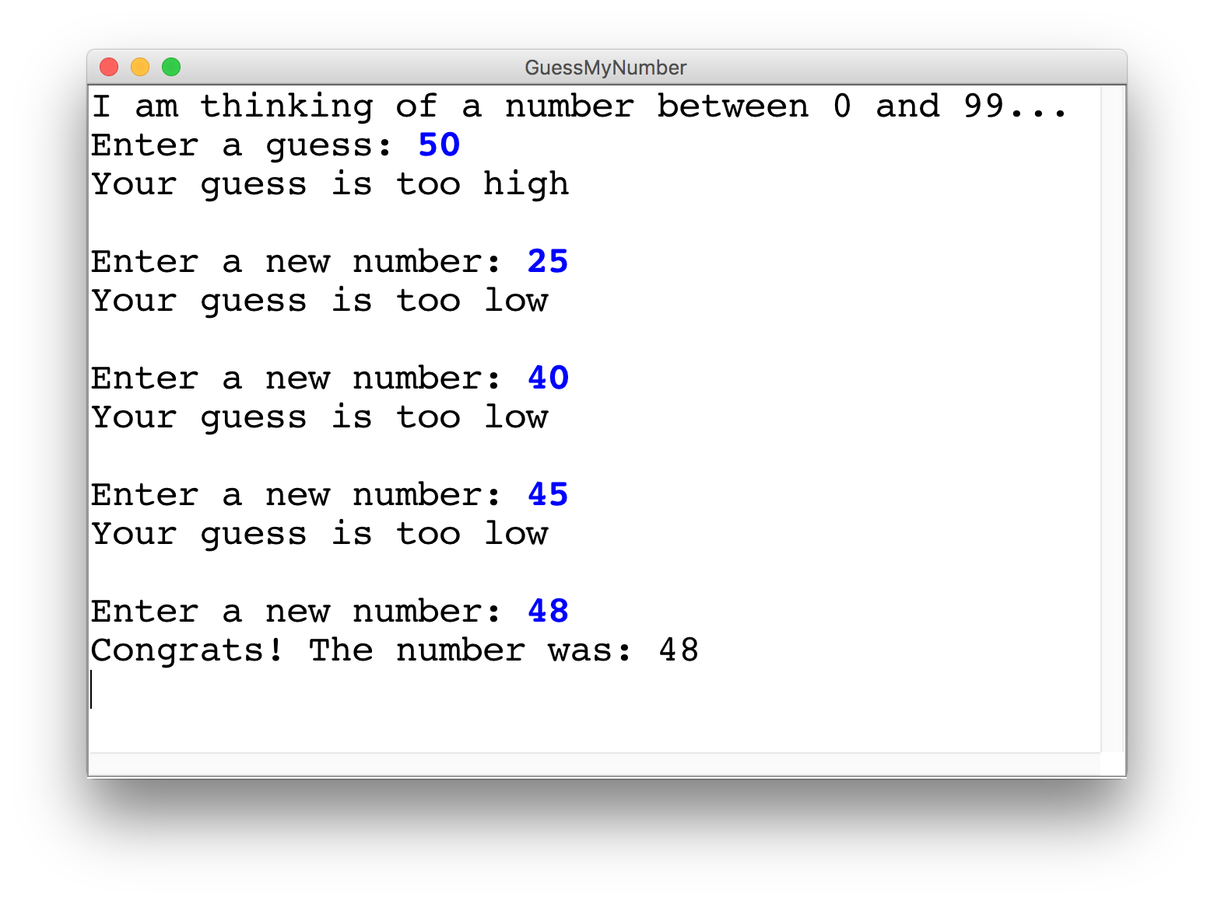
Guess My Number

Slide 83
Guess My Number
int secretNumber = getHeight() % 100;
println("I am thinking of a number between 0 and 99...");
int guess = readInt("Enter a guess: ");
// true if guess is not equal to secret number
while(guess != secretNumber) {
// true if guess is less than secret number
if(guess < secretNumber) {
println("Your guess is too low");
} else {
println("Your guess is too high");
}
println(""); // an empty line
guess = readInt("Enter a new number: ");
}
println("Congrats! The number was: " + secretNumber);
92
secretNumber

Slide 84
Guess My Number
int secretNumber = getHeight() % 100;
println("I am thinking of a number between 0 and 99...");
int guess = readInt("Enter a guess: ");
// true if guess is not equal to secret number
while(guess != secretNumber) {
// true if guess is less than secret number
if(guess < secretNumber) {
println("Your guess is too low");
} else {
println("Your guess is too high");
}
println(""); // an empty line
guess = readInt("Enter a new number: ");
}
println("Congrats! The number was: " + secretNumber);
92
secretNumber

Slide 85
Guess My Number
int secretNumber = getHeight() % 100;
println("I am thinking of a number between 0 and 99...");
int guess = readInt("Enter a guess: ");
// true if guess is not equal to secret number
while(guess != secretNumber) {
// true if guess is less than secret number
if(guess < secretNumber) {
println("Your guess is too low");
} else {
println("Your guess is too high");
}
println(""); // an empty line
guess = readInt("Enter a new number: ");
}
println("Congrats! The number was: " + secretNumber);
50
92
guess
secretNumber

Slide 86
Guess My Number
int secretNumber = getHeight() % 100;
println("I am thinking of a number between 0 and 99...");
int guess = readInt("Enter a guess: ");
// true if guess is not equal to secret number
while(guess != secretNumber) {
// true if guess is less than secret number
if(guess < secretNumber) {
println("Your guess is too low");
} else {
println("Your guess is too high");
}
println(""); // an empty line
guess = readInt("Enter a new number: ");
}
println("Congrats! The number was: " + secretNumber);
50
92
guess
secretNumber

Slide 87
Guess My Number
int secretNumber = getHeight() % 100;
println("I am thinking of a number between 0 and 99...");
int guess = readInt("Enter a guess: ");
// true if guess is not equal to secret number
while(guess != secretNumber) {
// true if guess is less than secret number
if(guess < secretNumber) {
println("Your guess is too low");
} else {
println("Your guess is too high");
}
println(""); // an empty line
guess = readInt("Enter a new number: ");
}
println("Congrats! The number was: " + secretNumber);
50
92
guess
secretNumber

Slide 88
Guess My Number
int secretNumber = getHeight() % 100;
println("I am thinking of a number between 0 and 99...");
int guess = readInt("Enter a guess: ");
// true if guess is not equal to secret number
while(guess != secretNumber) {
// true if guess is less than secret number
if(guess < secretNumber) {
println("Your guess is too low");
} else {
println("Your guess is too high");
}
println(""); // an empty line
guess = readInt("Enter a new number: ");
}
println("Congrats! The number was: " + secretNumber);
50
92
guess
secretNumber

Slide 89
Guess My Number
int secretNumber = getHeight() % 100;
println("I am thinking of a number between 0 and 99...");
int guess = readInt("Enter a guess: ");
// true if guess is not equal to secret number
while(guess != secretNumber) {
// true if guess is less than secret number
if(guess < secretNumber) {
println("Your guess is too low");
} else {
println("Your guess is too high");
}
println(""); // an empty line
guess = readInt("Enter a new number: ");
}
println("Congrats! The number was: " + secretNumber);
50
92
guess
secretNumber

Slide 90
Guess My Number
int secretNumber = getHeight() % 100;
println("I am thinking of a number between 0 and 99...");
int guess = readInt("Enter a guess: ");
// true if guess is not equal to secret number
while(guess != secretNumber) {
// true if guess is less than secret number
if(guess < secretNumber) {
println("Your guess is too low");
} else {
println("Your guess is too high");
}
println(""); // an empty line
guess = readInt("Enter a new number: ");
}
println("Congrats! The number was: " + secretNumber);
50
92
guess
secretNumber

Slide 91
Guess My Number
int secretNumber = getHeight() % 100;
println("I am thinking of a number between 0 and 99...");
int guess = readInt("Enter a guess: ");
// true if guess is not equal to secret number
while(guess != secretNumber) {
// true if guess is less than secret number
if(guess < secretNumber) {
println("Your guess is too low");
} else {
println("Your guess is too high");
}
println(""); // an empty line
guess = readInt("Enter a new number: ");
}
println("Congrats! The number was: " + secretNumber);
95
92
guess
secretNumber

Slide 92
Guess My Number
int secretNumber = getHeight() % 100;
println("I am thinking of a number between 0 and 99...");
int guess = readInt("Enter a guess: ");
// true if guess is not equal to secret number
while(guess != secretNumber) {
// true if guess is less than secret number
if(guess < secretNumber) {
println("Your guess is too low");
} else {
println("Your guess is too high");
}
println(""); // an empty line
guess = readInt("Enter a new number: ");
}
println("Congrats! The number was: " + secretNumber);
95
92
guess
secretNumber

Slide 93
Guess My Number
int secretNumber = getHeight() % 100;
println("I am thinking of a number between 0 and 99...");
int guess = readInt("Enter a guess: ");
// true if guess is not equal to secret number
while(guess != secretNumber) {
// true if guess is less than secret number
if(guess < secretNumber) {
println("Your guess is too low");
} else {
println("Your guess is too high");
}
println(""); // an empty line
guess = readInt("Enter a new number: ");
}
println("Congrats! The number was: " + secretNumber);
95
92
guess
secretNumber

Slide 94
Guess My Number
int secretNumber = getHeight() % 100;
println("I am thinking of a number between 0 and 99...");
int guess = readInt("Enter a guess: ");
// true if guess is not equal to secret number
while(guess != secretNumber) {
// true if guess is less than secret number
if(guess < secretNumber) {
println("Your guess is too low");
} else {
println("Your guess is too high");
}
println(""); // an empty line
guess = readInt("Enter a new number: ");
}
println("Congrats! The number was: " + secretNumber);
95
92
guess
secretNumber

Slide 95
Guess My Number
int secretNumber = getHeight() % 100;
println("I am thinking of a number between 0 and 99...");
int guess = readInt("Enter a guess: ");
// true if guess is not equal to secret number
while(guess != secretNumber) {
// true if guess is less than secret number
if(guess < secretNumber) {
println("Your guess is too low");
} else {
println("Your guess is too high");
}
println(""); // an empty line
guess = readInt("Enter a new number: ");
}
println("Congrats! The number was: " + secretNumber);
95
92
guess
secretNumber

Slide 96
Guess My Number
int secretNumber = getHeight() % 100;
println("I am thinking of a number between 0 and 99...");
int guess = readInt("Enter a guess: ");
// true if guess is not equal to secret number
while(guess != secretNumber) {
// true if guess is less than secret number
if(guess < secretNumber) {
println("Your guess is too low");
} else {
println("Your guess is too high");
}
println(""); // an empty line
guess = readInt("Enter a new number: ");
}
println("Congrats! The number was: " + secretNumber);
95
92
guess
secretNumber

Slide 97
Guess My Number
int secretNumber = getHeight() % 100;
println("I am thinking of a number between 0 and 99...");
int guess = readInt("Enter a guess: ");
// true if guess is not equal to secret number
while(guess != secretNumber) {
// true if guess is less than secret number
if(guess < secretNumber) {
println("Your guess is too low");
} else {
println("Your guess is too high");
}
println(""); // an empty line
guess = readInt("Enter a new number: ");
}
println("Congrats! The number was: " + secretNumber);
95
92
guess
secretNumber

Slide 98
Guess My Number
int secretNumber = getHeight() % 100;
println("I am thinking of a number between 0 and 99...");
int guess = readInt("Enter a guess: ");
// true if guess is not equal to secret number
while(guess != secretNumber) {
// true if guess is less than secret number
if(guess < secretNumber) {
println("Your guess is too low");
} else {
println("Your guess is too high");
}
println(""); // an empty line
guess = readInt("Enter a new number: ");
}
println("Congrats! The number was: " + secretNumber);
92
92
guess
secretNumber

Slide 99
Guess My Number
int secretNumber = getHeight() % 100;
println("I am thinking of a number between 0 and 99...");
int guess = readInt("Enter a guess: ");
// true if guess is not equal to secret number
while(guess != secretNumber) {
// true if guess is less than secret number
if(guess < secretNumber) {
println("Your guess is too low");
} else {
println("Your guess is too high");
}
println(""); // an empty line
guess = readInt("Enter a new number: ");
}
println("Congrats! The number was: " + secretNumber);
92
92
guess
secretNumber

Slide 100
Guess My Number
int secretNumber = getHeight() % 100;
println("I am thinking of a number between 0 and 99...");
int guess = readInt("Enter a guess: ");
// true if guess is not equal to secret number
while(guess != secretNumber) {
// true if guess is less than secret number
if(guess < secretNumber) {
println("Your guess is too low");
} else {
println("Your guess is too high");
}
println(""); // an empty line
guess = readInt("Enter a new number: ");
}
println("Congrats! The number was: " + secretNumber);
92
92
guess
secretNumber

Slide 101
Guess My Number
int secretNumber = getHeight() % 100;
println("I am thinking of a number between 0 and 99...");
int guess = readInt("Enter a guess: ");
// true if guess is not equal to secret number
while(guess != secretNumber) {
// true if guess is less than secret number
if(guess < secretNumber) {
println("Your guess is too low");
} else {
println("Your guess is too high");
}
println(""); // an empty line
guess = readInt("Enter a new number: ");
}
println("Congrats! The number was: " + secretNumber);
92
92
guess
secretNumber

Slide 102
Guess My Number
int secretNumber = getHeight() % 100;
println("I am thinking of a number between 0 and 99...");
int guess = readInt("Enter a guess: ");
// true if guess is not equal to secret number
while(guess != secretNumber) {
// true if guess is less than secret number
if(guess < secretNumber) {
println("Your guess is too low");
} else {
println("Your guess is too high");
}
println(""); // an empty line
guess = readInt("Enter a new number: ");
}
println("Congrats! The number was: " + secretNumber);

Slide 103
Binary Operators
+
Addition
*
Multiplication
–
Subtraction
/
Division
%
Remainder
Today is your day, tio

Slide 104
Remainder
// an example of the % operator
println(17 % 4);
// reads a number from the user
int num = readInt("?: ");
// stores the ones digit
int onesDigit = num % 10;
// equal to 1 if num is odd,
// 0 if num is even.
int isOdd = num % 2;

Slide 105
Guess My Number
int secretNumber = getHeight() % 100;
println("I am thinking of a number between 0 and 99...");
int guess = readInt("Enter a guess: ");
// true if guess is not equal to secret number
while(guess != secretNumber) {
// true if guess is less than secret number
if(guess < secretNumber) {
println("Your guess is too low");
} else {
println("Your guess is too high");
}
println(""); // an empty line
guess = readInt("Enter a new number: ");
}
println("Congrats! The number was: " + secretNumber);

Slide 106
Challenge: Sentinel Loops
sentinel: A value that signals the end of user input.
sentinel loop: Repeats until a sentinel value is seen.
Example: Write a program that prompts the user for numbers until the user types -1, then output the sum of the numbers.
In this case, -1 is the sentinel value.
Type a number: 10
Type a number: 20
Type a number: 30
Type a number: -1
Sum is 60
Notes:
11:45AM
Think pair share (hint: fencepost)

Slide 108
Example: Sentinel Loops
// fencepost problem!
// ask for number - post
// add number to sum - fence
int sum = 0;
int num = readInt("Enter a number: ");
while (num != -1) {
sum += num;
num = readInt("Enter a number: ");
}
println("Sum is " + sum);

Slide 109
Example: Sentinel Loops
// fencepost problem!
// ask for number - post
// add number to sum - fence
int sum = 0;
int num = readInt("Enter a number: ");
while (num != -1) {
sum += num;
num = readInt("Enter a number: ");
}
println("Sum is " + sum);

Slide 110
Example: Sentinel Loops
// Solution #2
// harder to see loop end condition here
int sum = 0;
while (true) {
int num = readInt("Enter a number: ");
if (num == -1) {
break; // immediately exits loop
}
sum += num;
}
println("Sum is " + sum);
Notes:
Break exits the closest loop it is in
”Loop and a half” – not as good style
You can have more complex conditions if you want…

Slide 111
Logical Operators
In order of precedence:
Operator | Description | Example | Result
! | not | !(2 == 3) | true
&& | and | (2 == 3) && (-1 < 5) | false
|| | or | (2 == 3) || (-1 < 5) | true
Cannot "chain" tests as in algebra; use && or || instead
// assume x is 15 // correct version
2 <= x <= 10 2 <= x && x <= 10
true <= 10 true && false
Error! false

Slide 112
Precedence Madness
Precedence:
! > arithmetic > comparison > logical
5 * 7 >= 3 + 5 * (7 – 1) && !false
Notes:
You can store boolean expressions in variables too

Slide 113
Precedence Madness
Precedence:
! > arithmetic > comparison > logical
5 * 7 >= 3 + 5 * (7 – 1) && !false
5 * 7 >= 3 + 5 * 6 && !false
Notes:
You can store boolean expressions in variables too

Slide 114
Precedence Madness
Precedence:
! > arithmetic > comparison > logical
5 * 7 >= 3 + 5 * (7 – 1) && !false
5 * 7 >= 3 + 5 * 6 && !false
5 * 7 >= 3 + 5 * 6 && true
Notes:
You can store boolean expressions in variables too

Slide 115
Precedence Madness
Precedence:
! > arithmetic > comparison > logical
5 * 7 >= 3 + 5 * (7 – 1) && !false
5 * 7 >= 3 + 5 * 6 && !false
5 * 7 >= 3 + 5 * 6 && true
35 >= 3 + 30 && true
Notes:
You can store boolean expressions in variables too

Slide 116
Precedence Madness
Precedence:
! > arithmetic > comparison > logical
5 * 7 >= 3 + 5 * (7 – 1) && !false
5 * 7 >= 3 + 5 * 6 && !false
5 * 7 >= 3 + 5 * 6 && true
35 >= 3 + 30 && true
35 >= 33 && true
Notes:
You can store boolean expressions in variables too

Slide 117
Precedence Madness
Precedence:
! > arithmetic > comparison > logical
5 * 7 >= 3 + 5 * (7 – 1) && !false
5 * 7 >= 3 + 5 * 6 && !false
5 * 7 >= 3 + 5 * 6 && true
35 >= 3 + 30 && true
35 >= 33 && true
true && true
Notes:
You can store boolean expressions in variables too

Slide 118
Precedence Madness
Precedence:
! > arithmetic > comparison > logical
5 * 7 >= 3 + 5 * (7 – 1) && !false
5 * 7 >= 3 + 5 * 6 && !false
5 * 7 >= 3 + 5 * 6 && true
35 >= 3 + 30 && true
35 >= 33 && true
true && true
true
Never write code like this ☺
Notes:
You can store boolean expressions in variables too

Slide 119
George Boole
English Mathematician 1815 – 1864
Boole died of being too cool

Slide 120
Boolean Variables
// Store expressions that evaluate to true/false
boolean x = 1 < 2; // true
boolean y = 5.0 == 4.0; // false

Slide 121
Boolean Variables
// Store expressions that evaluate to true/false
boolean x = 1 < 2; // true
boolean y = 5.0 == 4.0; // false
// Directly set to true/false
boolean isFamilyVisiting = true;
boolean isRaining = false;

Slide 122
Boolean Variables
// Store expressions that evaluate to true/false
boolean x = 1 < 2; // true
boolean y = 5.0 == 4.0; // false
// Directly set to true/false
boolean isFamilyVisiting = true;
boolean isRaining = false;
// Ask the user a true/false (yes/no) question
boolean playAgain = readBoolean("Play again?”, "y", "n");
if (playAgain) {
...
Notes:
Note: does not store the whole expression – just the value.
Note – we don’t need to check if it’s true

Slide 123
boolean isAllowed = !food || drinks;
*know your logical precedence

Slide 124
Today’s Route
You are here
Simple Java
For Loops
Scope
Conditions
Review
The River of Java

Slide 125
How would you println “Stanford rocks socks”
100 times

Slide 126
For Loop Redux
public void run() {
for(int i = 0; i < 100; i++) {
println(“Stanford rocks socks!”);
}
}

Slide 127
For Loop Redux
Enters the loop if this condition passes
This line is run each time the code gets to the end of the ‘body’
This line is run once, just before the for loop starts
for(int i = 0; i < 100; i++) {
println(“Stanford rocks socks!”);
}

Slide 128

For Loop Redux
for(int i = 0; i < 3; i++) {
println(“Stanford rocks socks!”);
}
For Loop Redux

Slide 129
For Loop Redux
for(int i = 0; i < 3; i++) {
println(“Stanford rocks socks!”);
}
For Loop Redux

Slide 130
For Loop Redux
i
0
for(int i = 0; i < 3; i++) {
println(“Stanford rocks socks!”);
}
For Loop Redux

Slide 131
For Loop Redux
i
0
for(int i = 0; i < 3; i++) {
println(“Stanford rocks socks!”);
}
For Loop Redux

Slide 132
For Loop Redux
i
0
for(int i = 0; i < 3; i++) {
println(“Stanford rocks socks!”);
}
For Loop Redux
Stanford rocks socks

Slide 133
For Loop Redux
i
1
for(int i = 0; i < 3; i++) {
println(“Stanford rocks socks!”);
}
For Loop Redux
Stanford rocks socks

Slide 134
For Loop Redux
i
1
for(int i = 0; i < 3; i++) {
println(“Stanford rocks socks!”);
}
For Loop Redux
Stanford rocks socks

Slide 135
For Loop Redux
i
1
for(int i = 0; i < 3; i++) {
println(“Stanford rocks socks!”);
}
For Loop Redux
Stanford rocks socks
Stanford rocks socks

Slide 136
For Loop Redux
i
2
for(int i = 0; i < 3; i++) {
println(“Stanford rocks socks!”);
}
For Loop Redux
Stanford rocks socks
Stanford rocks socks

Slide 137
For Loop Redux
i
2
for(int i = 0; i < 3; i++) {
println(“Stanford rocks socks!”);
}
For Loop Redux
Stanford rocks socks
Stanford rocks socks

Slide 138
For Loop Redux
i
2
for(int i = 0; i < 3; i++) {
println(“Stanford rocks socks!”);
}
For Loop Redux
Stanford rocks socks
Stanford rocks socks
Stanford rocks socks

Slide 139
For Loop Redux
i
3
for(int i = 0; i < 3; i++) {
println(“Stanford rocks socks!”);
}
For Loop Redux
Stanford rocks socks
Stanford rocks socks
Stanford rocks socks

Slide 140
For Loop Redux
i
3
for(int i = 0; i < 3; i++) {
println(“Stanford rocks socks!”);
}
For Loop Redux
Stanford rocks socks
Stanford rocks socks
Stanford rocks socks

Slide 141
For Loop Redux
for(int i = 0; i < 3; i++) {
println(“Stanford rocks socks!”);
}
For Loop Redux
Stanford rocks socks
Stanford rocks socks
Stanford rocks socks

Slide 142
For Loop Redux
for(int i = 0; i < 3; i++) {
println(“Stanford rocks socks!”);
}
For Loop Redux
Stanford rocks socks
Stanford rocks socks
Stanford rocks socks

Slide 143
You can use the for loop variable

Slide 144
How would you println the first 100 even numbers?

Slide 145
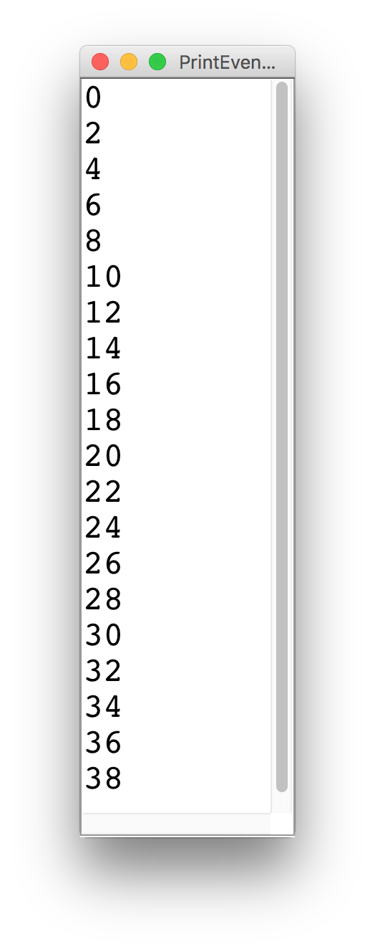
Printing Even Numbers

Slide 146
Printing Even Numbers
for(int i = 0; i < NUM_NUMS; i++) {
println(i * 2);
}

Slide 147
Printing Even Numbers
for(int i = 0; i < 3; i++) {
println(i * 2);
}
For Loop Redux

Slide 148
Printing Even Numbers
for(int i = 0; i < 3; i++) {
println(i * 2);
}
For Loop Redux

Slide 149
Printing Even Numbers
i
0
for(int i = 0; i < 3; i++) {
println(i * 2);
}
For Loop Redux

Slide 150
Printing Even Numbers
i
0
for(int i = 0; i < 3; i++) {
println(i * 2);
}
For Loop Redux

Slide 151
Printing Even Numbers
i
0
for(int i = 0; i < 3; i++) {
println(i * 2);
}
For Loop Redux
0

Slide 152
Printing Even Numbers
i
1
for(int i = 0; i < 3; i++) {
println(i * 2);
}
For Loop Redux
0

Slide 153
Printing Even Numbers
i
1
for(int i = 0; i < 3; i++) {
println(i * 2);
}
For Loop Redux
0

Slide 154
Printing Even Numbers
i
1
for(int i = 0; i < 3; i++) {
println(i * 2);
}
For Loop Redux
0
2

Slide 155
Printing Even Numbers
i
2
for(int i = 0; i < 3; i++) {
println(i * 2);
}
For Loop Redux
0
2

Slide 156
Printing Even Numbers
i
2
for(int i = 0; i < 3; i++) {
println(i * 2);
}
For Loop Redux
0
2

Slide 157
Printing Even Numbers
i
2
for(int i = 0; i < 3; i++) {
println(i * 2);
}
For Loop Redux
0
2
4

Slide 158
Printing Even Numbers
i
3
for(int i = 0; i < 3; i++) {
println(i * 2);
}
For Loop Redux
0
2
4

Slide 159
Printing Even Numbers
i
3
for(int i = 0; i < 3; i++) {
println(i * 2);
}
For Loop Redux
0
2
4

Slide 160
Printing Even Numbers
i
3
for(int i = 0; i < 3; i++) {
println(i * 2);
}
For Loop Redux
0
2
4

Slide 161
Printing Even Numbers
for(int i = 0; i < 3; i++) {
println(i * 2);
}
For Loop Redux
0
2
4

Slide 162
That’s all
public void run() {
for(int i = 0; i < 999999; i++) {
println(“You rock!”);
println(“See you on Friday”);
}
}

Slide 163
Today’s Route
You are here
Simple Java
For Loops
Scope
Conditions
Review
The River of Java

Slide 164
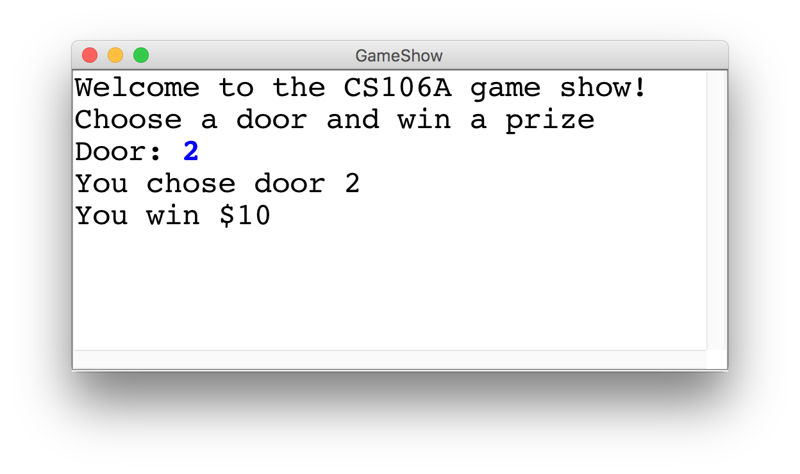
Game Show

Slide 165
Choose a Door
int door = readInt("Door: ");
// while the input is invalid
while(door < 1 || door > 3) {
// tell the user the input was invalid
println("Invalid door!");
// ask for a new input
door = readInt("Door: ");
}
|| or
&& and

Slide 166
The Door Logic
int prize = 4;
if(door == 1) {
prize = 2 + 9 / 10 * 100;
} else if(door == 2) {
boolean locked = prize % 2 != 0;
if(!locked) {
prize += 6;
}
} else if(door == 3) {
prize++;
}

Slide 167
The Door Logic
int prize = 4;
if(door == 1) {
prize = 2 + 9 / 10 * 100;
} else if(door == 2) {
boolean locked = prize % 2 != 0;
if(!locked) {
prize += 6;
}
} else if(door == 3) {
prize++;
}

Slide 168
The Door Logic
int prize = 4;
if(door == 1) {
prize = 2 + 9 / 10 * 100;
} else if(door == 2) {
boolean locked = prize % 2 != 0;
if(!locked) {
prize += 6;
}
} else if(door == 3) {
prize++;
}

Slide 169
The Door Logic
int prize = 4;
if(door == 1) {
prize = 2 + 9 / 10 * 100;
} else if(door == 2) {
boolean locked = prize % 2 != 0;
if(!locked) {
prize += 6;
}
} else if(door == 3) {
prize++;
}

Slide 170
The Door Logic
int prize = 4;
if(door == 1) {
prize = 2 + 9 / 10 * 100;
} else if(door == 2) {
boolean locked = prize % 2 != 0;
if(!locked) {
prize += 6;
}
} else if(door == 3) {
prize++;
}

Slide 171
Today’s Goal
Be able to use For / While / If in Java

